Slide 1
ARDUINO-BASED
ARDUINO
UNO R3
WEATHER MONITORING
SYSTEM
Real-Time Environmental Data Collection & Display
DHT11
LDR
Moisture
Rain Sensor
LCD Display
Microprocessors Project | Arduino Uno | Group Presentation

Slide 2
GROUP MEMBERS
PROGRAM
[BSc Computer Engineering / Microprocessors]
Project Team
1
2
Derrick Akpah Dodzi
Akussah Mcbright Dziedzorm
Index No. 7262123
Index No. 7262323
3
4
Adams Hussein Adbul Hakeem
Konadu Akosua Offeibeah
Index No. 7258523
Index No. 7273623
5
6
Ashong Emmanuel Adjei
Alorgbey Vanessa
Index No. 7265723
Index No. 7262623
Arduino-Based Weather Monitoring System

Slide 3
PROJECT OVERVIEW & OBJECTIVES
An Arduino Uno-based system that collects and displays environmental data in real time using multiple sensors on an HD44780 LCD screen.
🌡️ Temperature
💧 Humidity
Measure ambient temperature in °C using DHT11
Monitor relative humidity levels (%) continuously
☀️ Light Intensity
🌱 Soil Moisture
Convert LDR resistance to estimated Lux value
Map analog reading to 0–100% moisture percentage
🌧️ Rain Detection
Digital detection: display RAINING or NO RAIN

Slide 4
COMPONENTS & HARDWARE
1
Arduino Uno R3
Digital & Analog Pins
Microcontroller — Brain of the system
2
DHT11 Sensor
Analog Pin A0
Temperature & Humidity measurement
3
LDR (Light Sensor)
Analog Pin A1
Ambient light intensity detection
4
Moisture Sensor
Analog Pin A2
Soil/surface moisture level (0–100%)
5
Rain Sensor (HL-83)
Digital Pin D2
Rainfall detection (digital HIGH/LOW)
6
HD44780 LCD (LM044L)
Pins 8–13
20×4 character display in 4-bit mode

Slide 5
LCD INTERFACE & COMMUNICATION
Display Model
TM:28°C HM:65%
HD44780 / LM044L (20×4 LCD)
Mode
AM:72% LI:420Lx
4-bit mode — reduces required wiring
Arduino Pins
Pins 8–13 connected to LCD data lines
Library Used
HD44780 LCD — 20×4, 4-bit Mode
LiquidCrystal (built-in Arduino library)
Positioning
lcd.setCursor() places each value precisely
Welcome Message
Displays "WEATHER STATION" on startup (setup)
Update Rate
Continuous — refreshed every loop() cycle

Slide 6
TEMPERATURE & HUMIDITY — DHT11
0–50°C
20–90%
A0
Temperature Range
Humidity Range
Arduino Pin
DHT11 is a single-wire digital sensor outputting temperature and humidity
Connected to analog pin A0 on the Arduino Uno
Temperature displayed as TM (°C) on the LCD screen
Humidity displayed as HM (%) on the LCD screen
Values are read using the DHT library's .readTemperature() and .readHumidity() functions
Sensor is polled continuously in the loop() function for real-time readings

Slide 7
LIGHT INTENSITY SENSOR — LDR
1
2
3
4
5
Light Falls on LDR
Voltage Divider
ADC Reading
Lux Conversion
LCD Display
Resistance changes
with light intensity
R1 (100Ω) + LDR
creates variable voltage
Arduino reads 0–1023
on analog pin A1
Value mapped to
estimated Lux level
Displayed as LI
on the screen
Pin
Raw Output
LCD Label
Pull-down
Analog Pin A1
0 to 1023 (10-bit ADC)
LI (Light Intensity)
100Ω resistor (R1)
int S2 = analogRead(A1); // Read raw 0–1023
int LI = S2 * 2.1; // Multiply by 2.1 to get Lux estimate

Slide 8
MOISTURE SENSOR & RAIN DETECTION
💧 MOISTURE SENSOR
🌧️ RAIN SENSOR (HL-83)
Connected to Analog Pin A2
Connected to Digital Pin D2
Raw ADC output: 0 to 1023
Digital output: HIGH or LOW
map() converts reading to 0–100%
Water detected → pin reads HIGH
Displayed on LCD as AM
No water → pin reads LOW
Dry soil → high reading (low moisture)
LCD shows RAINING… or NO RAIN
Wet soil → low reading (high moisture)
HL-83 module with comparator circuit
int AM = map(analogRead(A2), 0, 1023, 0, 100);
NO RAIN
RAINING…

Slide 9
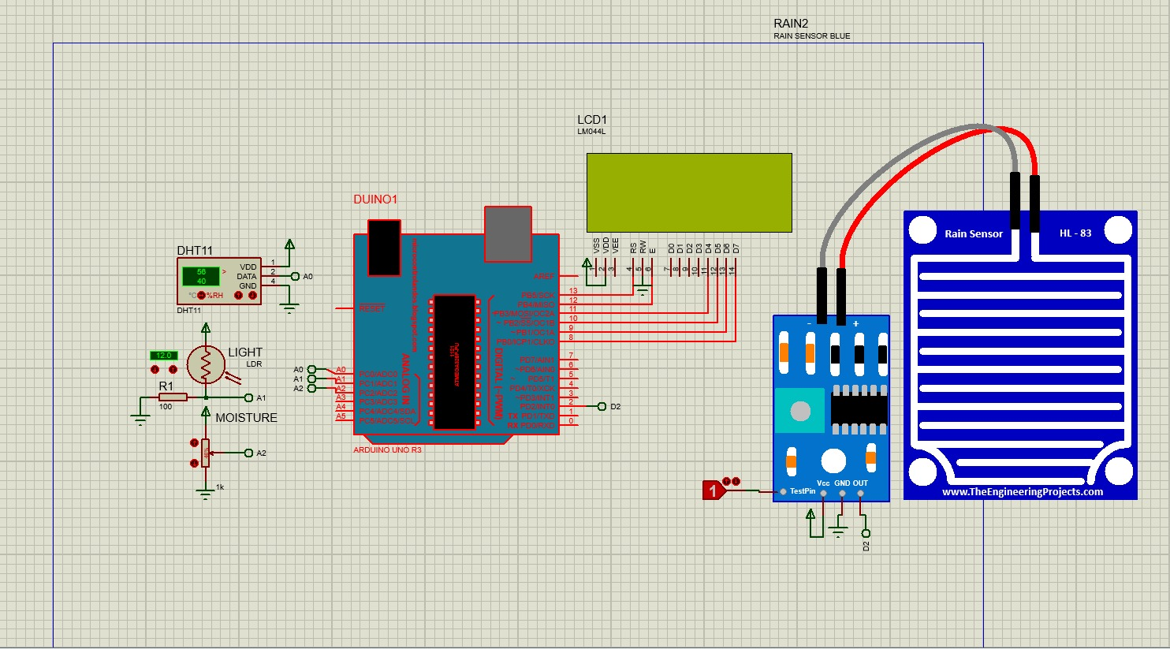
CIRCUIT SCHEMATIC
[ Circuit Simulation Schematic ]
Proteus / Simulation Screenshot
DHT11 • LDR • Moisture Sensor
Rain Sensor • Arduino Uno • LCD
PIN CONNECTIONS
DHT11
A0
Analog
LDR
A1
Analog
Moisture
A2
Analog
Rain Sensor
D2
Digital
LCD (RS–D7)
8–13
Digital
Insert schematic screenshot here

Slide 10
SOFTWARE LOGIC & INTEGRATION
setup()
loop()
1
Initialize LCD display
Read DHT11 → TM & HM values
2
Set LCD columns & rows
Read LDR → calculate Lux (LI)
→
3
Configure sensor pin modes
Read Moisture → map to % (AM)
4
Begin serial communication
Read Rain Sensor → RAINING/NO RAIN
5
Display welcome screen
Update LCD with all readings
↻ loop() runs continuously — sensors are polled and LCD is updated every cycle

Slide 11
APPLICATIONS & FUTURE IMPROVEMENTS
WHERE IT CAN BE USED
FUTURE IMPROVEMENTS
Farms
IoT Integration
Monitor soil moisture & rainfall for irrigation decisions
Send data to cloud via ESP8266/ESP32 Wi-Fi module
Greenhouses
Data Logging
Track humidity & temperature for plant health
Store readings on SD card for historical analysis
Smart Homes
Accurate Sensors
Automate climate monitoring & alerts
Upgrade to DHT22 or BME280 for better precision
Schools
Mobile Alerts
Demonstrate embedded system principles
Send notifications when thresholds are exceeded

Slide 12
CONCLUSION
A Complete Environmental
Monitoring Solution
4
2
Sensors
Pin Types
(Analog+Digital)
Successfully integrates 4 sensors into one Arduino Uno system
Real-time display via HD44780 LCD in 4-bit communication mode
1
∞
Covers temperature, humidity, light intensity, soil moisture & rainfall
Demonstrates core embedded systems concepts: ADC, digital I/O, libraries
LCD Output
Loop Cycles
Scalable — ready for IoT, data logging, and real-world deployment
Thank You | Arduino Weather Monitoring System | Questions?

